Slide 1
CSE2101: Object Oriented Programming-II (Java)
Lecture 12

Slide 2
CSE2101-OOP in Java
Input / Output
Notes:
This week we are going to look at input and output as handled by Java. Up to now in both this subject and previous ones you have mostly been provided with mechanisms to handle Text input and output, and have not dealt with file IO at all. The mechanisms we are going to look at today and Wednesday will introduce these topics in terms of how they are handled by the Java language.

Slide 3
I/O mechanisms
All programs need I/O to communicate with the outside world
I/O can be textual, graphical, through sensors, external devices, etc
For desk computers: usually screen, keyboard, network, file system
For embedded systems: all sorts of sensors and machinery
Notes:
Just as a program which can only store one object is not a lot of use, a program which needs to have all of its information re-entered every time you use it is not very useful either. We have been a little spoilt by bluej to date, as bluej provides our programs with a way of communicating with the outside world without very much work from us. This is great for testing and allows us to learn about other aspects of programming very easily but is not very useful in the real world.
There are lots of ways computer programs communicate with the outside world. These can include:
read slide.

Slide 4
Output Mechanisms
Text to terminal, printer, etc.
Data to file.
Data to other programs, network, etc.
Windows, graphics (GUI).
Notes:
IO should be thought of in terms of your program
can be divided into two parts. Input and Output.
In this programming course, we have spent more time dealing with the first two types of output to date, and as a user of computer systems you have probably dealt with the remaining types at some point.
When BlueJ provides you with method results, this is a form of output, which it is important to distinguished from the second type of output to the terminal window.
Writing data to a file, is not something we have dealt with as yet but will look at in more detail later in the week. Passing data to other programs via a network or via the internet is outside the scope of what we will cover, so will be left to another subject. And many of you have now dealt with GUI output in one form or another.

Slide 5
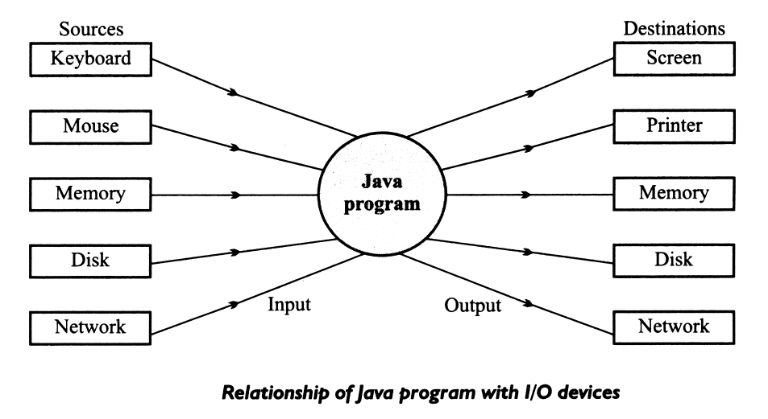
I/O and Data Movement
The flow of data into a program (input) may come from different devices such as keyboard, mouse, memory, disk, network, or another program.
The flow of data out of a program (output) may go to the screen, printer, memory, disk, network, another program.
Both input and output share a certain common property such as unidirectional movement of data – a sequence of bytes and characters and support to the sequential access to the data.

Slide 6
The Java IO package
Provided as part of the JDK
Contains classes and interfaces to use when dealing with different types of input and output
includes
10 Interfaces
50 Classes
16 Runtime Exceptions
Notes:
As with other parts of the Java language, tools needed to perform input and output have been gathered together in a package called predictably enough IO. This package is provided as part of the JDK, and is there for you to use. Its fairly large, and includes 10 interfaces, 50 classes and defines 16 runtime exceptions all of which together make up the Java IO facilities.
We are not going to attempt to cover all of this by any means, but we will provide you with an overview, and enough information to get you started.

Slide 7
Java I/O mechanisms
In Java, IO is done through a set of classes
For I/O: no new language construct (just new classes)
The classes provide several interfaces to streams and other IO concepts
First, we look at streams.
Notes:
Down to business.
As we have stated in Java IO is handled by using the classes described in the IO package. We don't need to learn any new language constructs, just how to use these classes which we do by making use of a number of interfaces, which give us access to Streams and a number of other IO concepts.
For today we will start with streams.

Slide 8
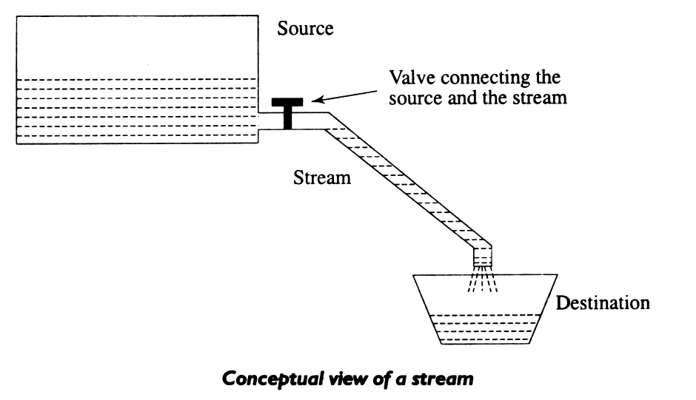
Streams
Java Uses the concept of Streams to represent the ordered sequence of data, a common characteristic shared by all I/O devices.
Streams presents a uniform, easy to use, object oriented interface between the program and I/O devices.
A stream in Java is a path along which data flows (like a river or pipe along which water flows).

Slide 9
Streams
a stream
reads
source
Program
writes
dest
Program
Notes:
Java uses the concept of a stream to provide an information source. In Java a stream can be thought of like a one way pipe through which information is passed. Information can be of any type, and in passed serially that is in single file one bit or sometimes one character at a time through the stream. The important point to note here is that streams deal with strictly one way traffic, they either read or write, not both.
go over slide

Slide 10
Java idioms
Writing
open a stream while(more information) write information to stream close the stream
Reading
open a stream while(more information) read information from stream close the stream
Notes:
Regardless of the type of data you are dealing with and the direction in which it is going, the concept is basically the same.
Read slide.

Slide 11
Stream Types
The concepts of sending data from one stream to another (like a pipe feeding into another pipe) has made streams powerful tool for file processing.
Connecting streams can also act as filters.
Streams are classified into two basic types:
Input Steam
Output Stream
Input Stream
reads
Source
Program
Output Stream
Program
Source
writes

Slide 12
Java Stream Classes
Input/Output related classes are defined in java.io package.
Input/Output in Java is defined in terms of streams.
A stream is a sequence of data, of no particular length.
Java classes can be categorised into two groups based on the data type one which they operate:
Byte streams
Character Streams

Slide 13
Text Data Vs Binary Data
Text files are human and text editor readable
Binary files are program readable
Notes:
For clarification purposes, you should be aware that : read slide.

Slide 14
Streams
Byte Streams | Character streams
Operated on 8 bit (1 byte) data. | Operates on 16-bit (2 byte) unicode characters.
Input streams/Output streams | Readers/ Writers

Slide 15
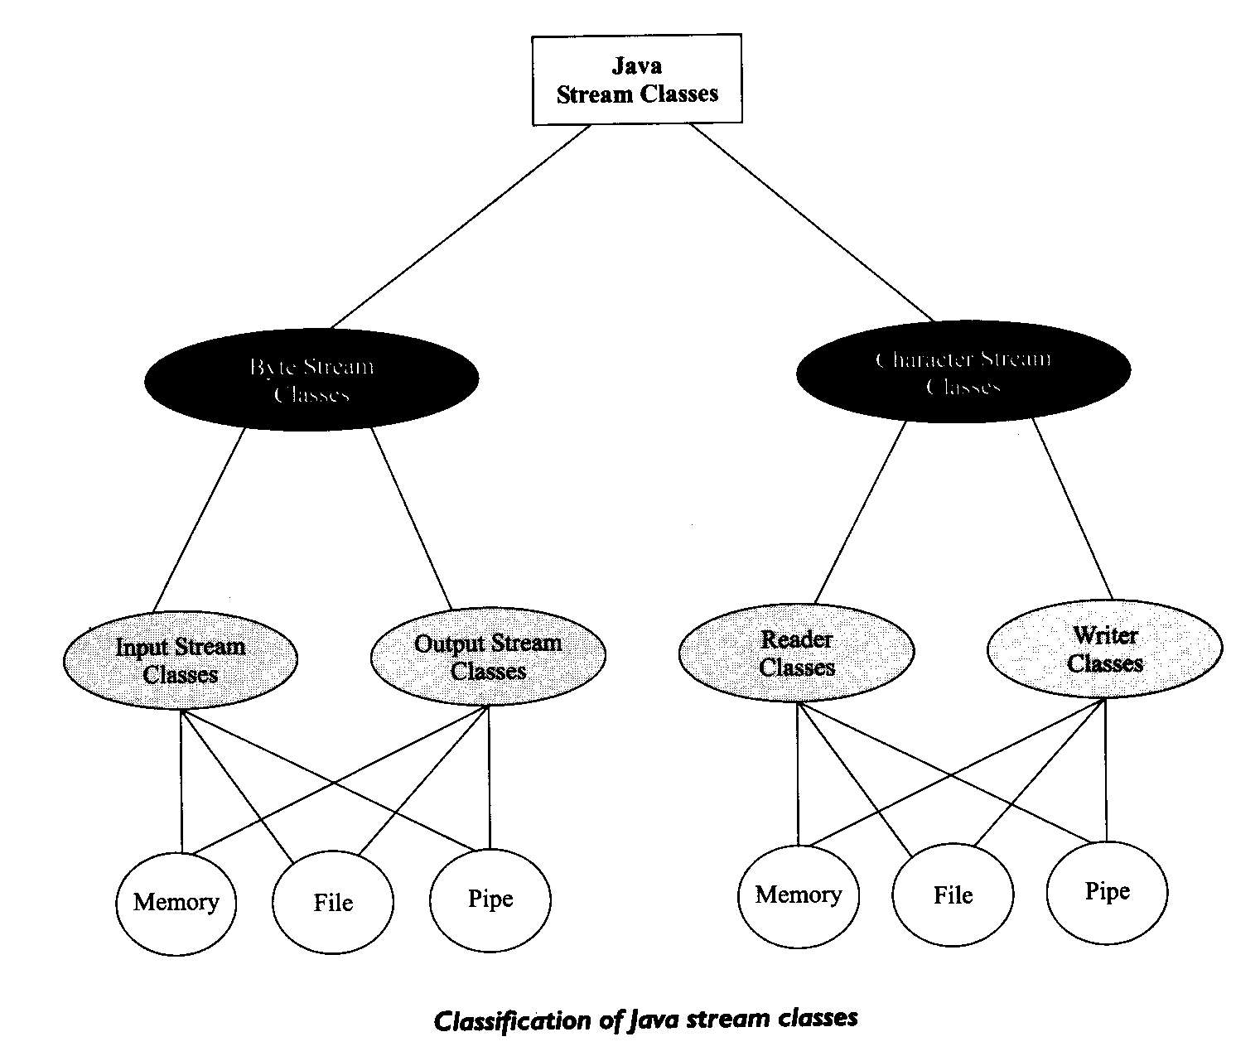
Classification of Java Stream Classes
Character Stream
classes
Byte Stream
classes

Slide 16
Byte Streams Vs Reader/writer
Reader/writer (characters)
Read,write characters
Are used for text input/output
Are preferred for text I/O
Streams (bytes)
Read/write bytes
Can be used for any data type
Are used for "serialisation"
Notes:
Here we have an overview of the purpose of the two hierarchies, which one you use is dependant upon what you want to do. Streams that is byte streams, shown in the right hand side of the previous slide, are used to read and write information as bytes. because of this these streams can read any sort of data. In particular these streams can by used for a technique called serialisation which is the process of reading or writing objects via a stream and reconstructing them at the other end. This process is called object serialisation and is an essential part of programming in the large, or distributed programming. This topic is outside the scope of this course, but there are a number of courses you may wish to do in later years which deal with this concept.
Reader and writer, are the abstract base classes on which character streams are based. They are used for text input and output. These classes were added to the Java API with version 1.1, and can be subclassed for various types of text input and output. We will look at these a little later.

Slide 17
Byte Input Streams
InputStream
ObjectInputStream
SequenceInputStream
ByteArrayInputStream
PipedInputStream
FileInputStream
FilterInputStream
StringBufferInputStream
PushbackInputStream
BufferedInputStream
DataInputStream

Slide 18
Byte Input Streams - operations
public abstract int read() | Reads a byte and returns as a integer 0-255
public int read(byte[] buf, int offset, int count) | Reads and stores the bytes in buf starting at offset. Count is the maximum read.
public int read(byte[] buf) | Same as previous offset=0 and length=buf.length()
public long skip(long count) | Skips count bytes.
public int available() | Returns the number of bytes that can be read.
public void close() | Closes stream

Slide 19
Java I/O – Using InputStreams
I/O in Java:
InputStream in = new FileInputStream(“c:\\temp\\myfile.txt”);
int b = in.read();
//EOF is signalled by read() returning -1
while (b != -1)
{
//do something…
b = in.read();
}
in.close();

Slide 20
Java I/O – Using InputStreams
Basic pattern for output is as follows:
Open a stream
While there’s data to write
Write the data
Close the stream

Slide 21
Reading: an example
BufferedReader reader =
new BufferedReader(new InputStreamReader(System.in));
try
{
while(true)
{
String line = reader.readLine();
System.out.println("the line was: " + line);
}
}
catch(IOException exc)
{
// an IO error occurred
}
Notes:
Hear is another example.
We see in the first line the declaration of a BufferedReader, called reader, this is a subclass of Reader as you might recall is the class used for reading characters, This class buffers the data read in. Can anyone recall why we do this? Otherwise we have to make a read call for every character.
Buffered reader is wrapped around an inputStreamReader. Also a subclass of Reader this class takes the stream to be read from as a parameter, in this case the data sink stream System.in and converts it from binary data to characters.
The while loop, checks for more data, by evaluating what is read in, the end of data is signified when a –1 is returned. You may recall that a –1 signifies a boolean false value. The data is read into a string and we can then do something with it. In this case we print it to the standard output or the terminal.
Notice that we enclose the call to ReadLine in a try block, as it has the potential to throw an IO exception. But that we declare the reader outside the try block. Can anyone say why this is the case?
Try block is still a block, anything declared inside it has only that scope.
Simple.

Slide 22
Reading (1)
Example from KeyboardReader Class
public KeyboardReader()
{
reader = new BufferedReader(new
InputStreamReader(System.in));
}
Notes:
Here is an example of reading text in from the keyboard using the KeyboardReader class
Here we can see a snippet of code which declares an instance of BufferedReader a subclass of reader which buffers strings read from the keyboard which is used to wrap an instance of an InputStreamReader, a class which also subclasses reader. This class provides an efficient way of converting bytes to characters. Because we read and write using streams we need to state which stream we are going to use. In this case printstream object System.in is used. We can then use the readline method of the reader class to get input from the keyboard. And class itself has methods to correctly handle different types of input.

Slide 23
KeyboardReader Class Methods
public String readString()
{
inputLine = "";
try
{
inputLine = reader.readLine();
}
catch(java.io.IOException anException)
{
// code not shown to save space
}
return inputLine;
}

Slide 24
KeyboardReader Class Methods
public int readInteger()
{
inputInteger = 0;
try {
inputLine = reader.readLine();
inputInteger = Integer.parseInt(inputLine);
}
catch(java.io.IOException anException) {}
catch(NumberFormatException anException){}
return inputInteger;
}
Notes:
Note use of parseInt and number format exception here.
Finish For Monday.

Slide 25
Byte Output Streams
OutputStream
ObjectOutputStream
SequenceOutputStream
ByteArrayOutputStream
PipedOutputStream
FileOutputStream
FilterOutputStream
PrintStream
BufferedOutputStream
DataOutputStream

Slide 26
Byte Output Streams - operations
public abstract void write(int b) | Write b as bytes.
public void write(byte[] buf, int offset, int count) | Write count bytes starting from offset in buf.
public void write(byte[] buf) | Same as previous offset=0 and count = buf.length()
public void flush() | Flushes the stream.
public void close() | Closes stream

Slide 27
PrintStream methods
public void print(boolean b)
public void print(char c)
public void print(double d)
public void print(float f)
public void print(int i)
public void print(long l)
public void print(String s)
public void print(Object o)
public void println(boolean b)
public void println (char c)
public void println (double d)
public void println (float f)
public void println (int i)
public void println (long l)
public void println (String s)
public void println (Object o)
Notes:
As you are aware when you pass something to be printed to System.out.print or println you can pass just about any sort of data and it will get printed on the screen. This is why, there are versions of both methods which can handle just about anything.

Slide 28
Byte Output Stream - example
Read from standard in and write to standard out
import java.io.*;
class ReadWrite {
public static void main(string[] args)
throws IOException
{
int b;
while (( b = System.in.read()) != -1)
{
System.out.write(b);
}
}

Slide 29
System.out
You have already used an io class implicitly when you write information to the screen.
System.out refers to a data attribute of the System class.
This attribute is an instance of the class PrintStream.
This class is used for output only.
The PrintStream class includes a method, println, that prints a string to the specified output.
We don’t know where this output comes from!
We don’t need to know – we just need to know where it goes to (i.e. the screen).

Slide 30
Handling User Input
To get input from the user, we use another data attribute of the System class: System.in
This attribute is an instance of the InputStream class.
The InputStream class is not easy to use (it works only with bytes).
To make things easier, we can wrap the input stream in other io classes.
In particular, we use two classes:
InputStreamReader. This class converts the byte stream into a character stream (this is much more useful – honestly!).
BufferedReader. This class buffers data from the enwrapped stream, allowing smoother reading of the stream (it doesn’t wait for the program to ask for the next character in the stream).

Slide 31
Handling User Input
To wrap an io object, we create a new io object, passing the old io object into the constructor.
For example, to wrap System.in within an InputStreamReader, we write: new InputStreamReader(System.in)
To use the BufferedReader (which, remember, is an optimisation), we wrap the InputStreamReader object we created above.
For example: new BufferedReader(new InputStreamReader(System.in))
Once we have a BufferedReader, we can use a nice method it provides called readLine() which reads a line of text!
This makes life much easier!

Slide 32
Handling User Input
Now that we have a way of reading a line of text from the System input stream (i.e. the keyboard), how do we use it?
public String readString() {
BufferedReader in = new BufferedReader(
new InputStreamReader(System.in));
String line = null;
try {
line = in.readLine();
while (line == null) {
line = in.readLine();
}
} catch (IOException ie) {
System.out.println(“The following problem occurred “ +
“when reading input: “ + ie);
}
return line;
}

Slide 33
File Processing
So far we have used variables and arrays for storing data inside the programs. This approach poses the following limitations:
The data is lost when variable goes out of scope or when the program terminates. That is data is stored in temporary/main memory is released when program terminates.
It is difficult to handle large volumes of data.
We can overcome this problem by storing data on secondary storage devices such as floppy or hard disks.
The data is stored in these devices using the concept of Files and such data is often called persistent data.

Slide 34
File Processing (cont.)
Storing and manipulating data using files is known as file processing.
Reading/Writing of data in a file can be performed at the level of bytes, characters, or fields depending on application requirements.
Java also provides capabilities to read and write class objects directly. The process of reading and writing objects is called object serialisation.

Slide 35
The File Class
java.io package includes:
- classes used to extract data from files
- classes used to place data within files
- class used to provide Java programs with mechanism for interacting with the file system: the File class
Class File
java.lang.Object
|
+--java.io.File
All Implemented Interfaces:
Comparable, Serializable

Slide 36
The File Class
Represents the pathname of a particular File, or directory
Ex: \Users\Smith\Java\read.me
Ex: read.me (in the current directory)
Uses
Listing existing files and directories
Creating new files and directories
Check for the existence of files
…

Slide 37
Creating a new File: Example
File (String pathname) Creates a new File instance by converting the given pathname string into an abstract pathname.
Example:
String fileName = “C:/fit2034.txt”
File file = new File(fileName);

Slide 38
Listing a Directory
public void listADirectory(String dirName)
{
File dirList = new File(dirName);
String[] dList = dirList.list();
for(int i = 0; i < dList.length; i++)
System.out.println(dList[i]);
}
String[] list() : Returns an array of strings naming the files and directories in the directory denoted by this abstract pathname.

Slide 39
FileReader interface
A class for reading character files
class FileReader (extends InputStreamReader):
public FileReader(File file)
throws FileNotFoundException
Creates a new FileReader, given the File to read from
public FileReader(FileDescriptor fd)
Creates a new FileReader, given the FileDescriptor to read from
public FileReader(String fileName)
throws FileNotFoundException
Creates a new FileReader, given the name of the file to read from
Notes:
So in order to read from a file, we use a subclass of InputStreamReader, called fileReader,
This class offers 3 constructors:
one of which takes an object of type file,
one of which takes a file descriptor, that is a handle to an underlying file,
and the last which takes a string, representing a filename. You will most likely be interested in the string version.
No new methods in that class

Slide 40
Creating a file reader
The code used to create a FileReader:
inputFile = new File(fromFile);
try
{
FileReader in = new FileReader(inputFile);
. . .
}
catch (FileNotFoundException fNF)
{
System.out.println(“File Not Found”);
}
Notes:
Here is the code which actually creates the FileReader. The new thing here is the class File, which is similar to the Collection class, in that it is a helper class and has methods which can be used to create files, get directory structures, check for the existence of files, and many more useful things.

Slide 41
FileReader methods (Inherited from Reader)
public int read() throws IOException
Read a single character. This method will block until a character is available, an I/O error occurs, or the end of the stream is reached.
Reads each character as an integer
Returns the character read, as an integer, or –1 when the end of the stream is reached.

Slide 42
FileReader Methods (Inherited from Reader)
abstract void close() Close the stream.
void mark(int readAheadLimit) Mark the present position in the stream.
boolean markSupported() Tell whether this stream supports the mark() operation. The default implementation always returns false.
Int read(char[] cbuf) Read characters into an array. Cbuf is the destination buffer. Return the number of characters read, or –1 when the end of the stream is reached.

Slide 43
FileReader Methods (Inherited from Reader)
abstract int read(char[] cbuf, int off, int len) Read characters into a portion of an array. Return the number of characters read…
boolean ready() Tell whether this stream is ready to be read.
Void reset() Reset the stream. If the stream has been marked, then attempt to reposition it at the mark.
long skip(long n) Skip characters. N is the number of characters to skip

Slide 44
The file reader structure
Read characters from a file
FileReader
File
a
text
file
Create, open a file
check whether file exists, etc.
File system (disc)
Read()
(returns the character, as an integer or -1 if at end)
Notes:
This is a graphical overview of how things work. The File reader and writer classes represents the stream we are reading from, we then use the File class to create and open a file, and to write the file to disk.

Slide 45
Casting to char
public void processFile(String fileName)
throws IOException
{
File inputFile = new File(fileName);
FileReader fr = new FileReader(inputFile);
int ch;
while ((ch = fr.read()) != -1)
processCharacter((char)ch);
fr.close();
}
public void processCharacter(char aChar)
{
...
}
cast needed!
Notes:
We saw that the read() method in the FileReader class returns the caracter read, as an INTEGER, or –1 when the end of the stream is reached.
If we were not writing to a stream but to some other device, or wish to write formatted characters, then we need to cast each int value read, into a character.
Cast to character has to be used to get character.
This method:
create a new File object with the name fileName
Create a new FileReader object with the File to read from
In the while loop, we READ a single character
We need to cast the result in order to get a character.

Slide 46
FileWriter interface
Class for writing character files
class FileWriter
extends OutputStreamWriter
FileWriter (File file) Constructs a FileWriter object given a File object.
FileWriter (FileDescriptor fd) Constructs a FileWriter object associated with a file descriptor.
Notes:
In order to write into a file, we use a subclass of Output Stream Writer, called FileWriter.
This class offers 5 constructors:
- READ THE SLIDE

Slide 47
FileWriter interface (2)
FileWriter(File file, boolean append) Constructs a FileWriter object given a File object. If the boolean is true, then bytes will be written to the end of the file rather than the beginning.
FileWriter(String fileName) Constructs a FileWriter object given a file name.
FileWriter(String fileName, boolean append) Constructs a FileWriter object given a file name with a boolean indicating whether or not to append the data written. If boolean is true, then the data will be written to the end of the file rather than the beginning
Notes:
READ THE SLIDE

Slide 48
FileWriter Methods (Inherited from Writer)
Reflect those found in FileReader
abstract void close() Close the stream, flushing it first.
abstract void flush() Flush the stream.
void write(char[] cbuf) Write an array of characters.
abstract void write(char[] cbuf, int off, int len) Write a portion of an array of characters.
void write(int c) Write a single character.
void write(String str) Write a string.
void write(String str, int off, int len) Write a portion of a string.
Notes:
READ THE SLIDE
(The parameters are the thing to be written in the FileWriter)

Slide 49
An example: copyFile
public void copyFile(String fromFile, String toFile)
throws IOException
{
File inputFile = new File(fromFile);
File outputFile = new File(toFile);
FileReader in = new FileReader(inputFile);
FileWriter out = new FileWriter(outputFile);
int ch;
while ((ch = in.read()) != -1)
out.write(c);
in.close();
out.close();
}
Notes:
Here we have an example of the use of FileReader and filewriter. This is a good example of using the data sink classes, that is those which read but do not process data.
The first thing we do, is create two new file objects,
we then create an input stream using FileReader, and an OutputStream using file writer,
we then read each character from the input file and write it to the output file.
And we Close both streams when we are finished.
Notice the test for end of stream and
processing the character as int is okay as long as it goes from stream to stream

Slide 50
Thank you

